Slide 1

New Year, New Perspective: Questions Every Educator Should Ask Themselves When Planning and Reflecting
Core Advocates Monthly Webinar
January 8, 2020 @7PM EST
The webinar will begin shortly.
Check your Resource widget to preview the resources for today’s session! Use the Group Chat to introduce yourself!
Notes:
First timer poll
Handouts:
While we’re waiting, we’d like you to participate in a quick poll so we can get an understanding of who’s on the webinar with us tonight.

Slide 2
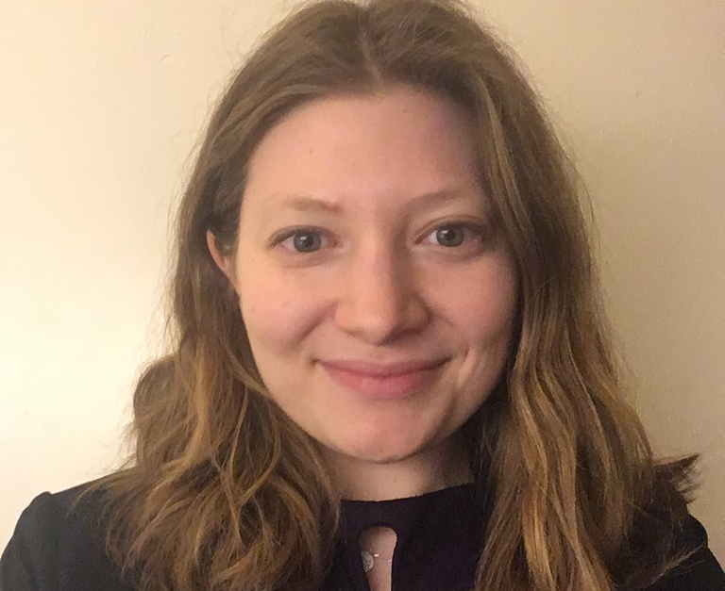
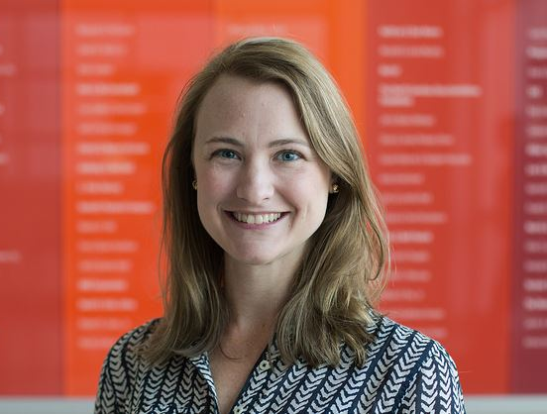
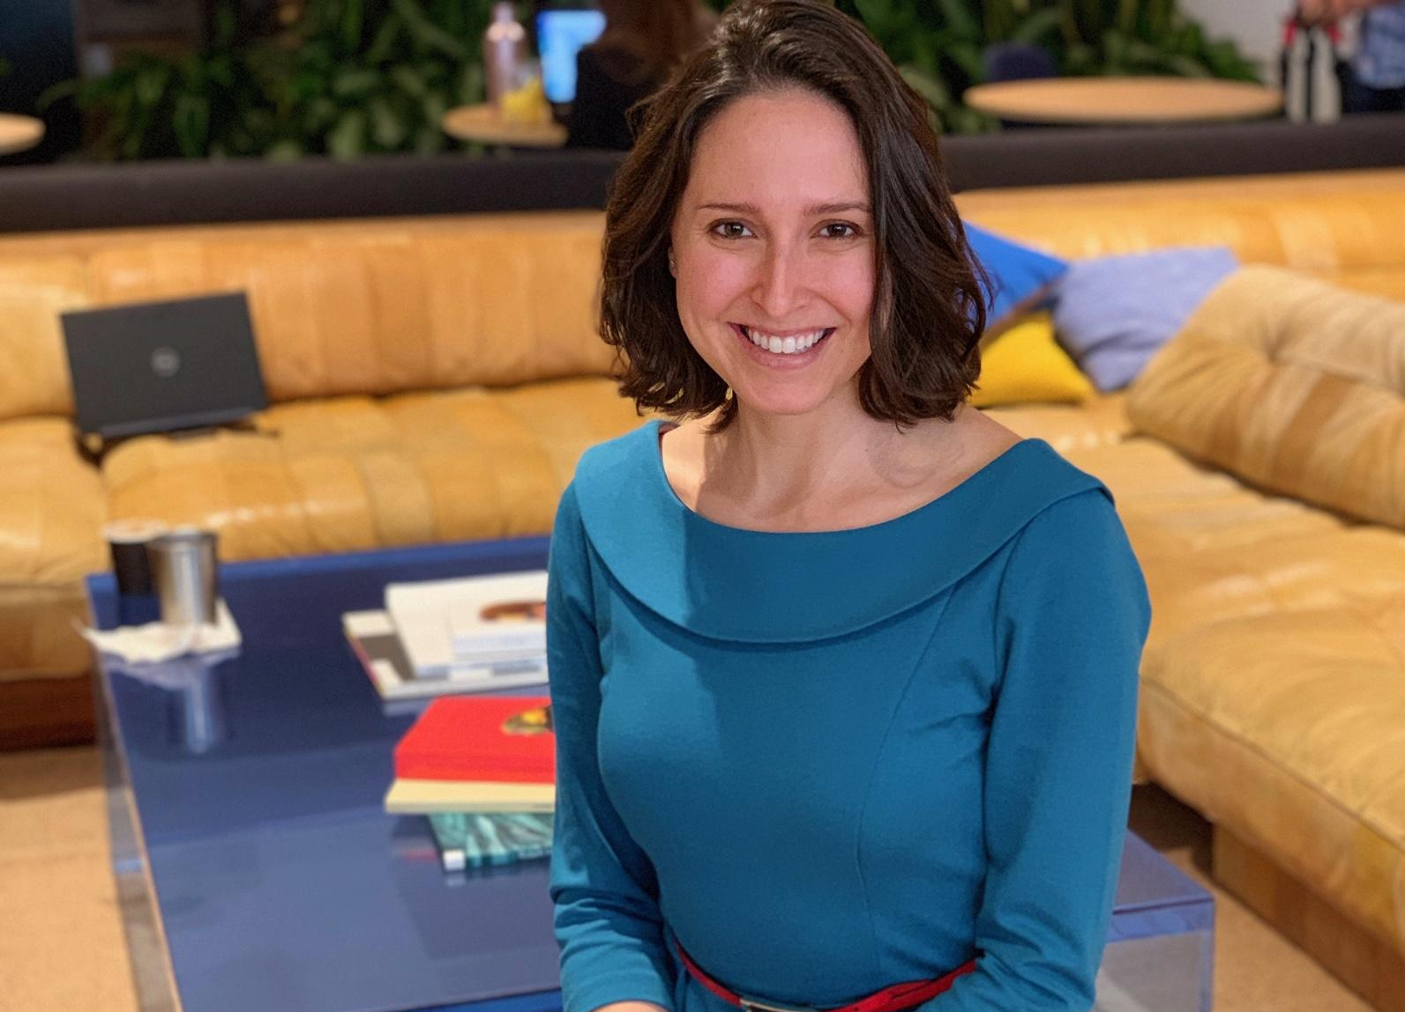
Introductions
This month’s presenters:
Kate Athens
Education Consultant
NYC
Susan Hitt
Digital Content Associate
Tools and Classroom Resources
Student Achievement Partners
Claire Rivero
Digital Strategy Manager
Tools and Classroom Resources
Student Achievement Partners

Slide 3
How many Core Advocate Webinars have you attended?
Please use the Questions tab on your control panel to respond.
If using a poll, please put up to 5 answer choices in the notes section below and indicate if attendees should choose only one response or multiple responses.

Slide 4


Learn More About Us!
Contact Jennie Beltramini (jbeltramini@studentsachieve.net )
Joy Delizo-Osborne
(jdelizo-osborne@studentsachieve.net)
Complete this survey to join our database (and mailing list): www.achievethecore.org/ca-signup
Visit our website: www.achievethecore.org
Notes:
If you’d like to learn more about the network, contact Jennie (her email is here).
We also want to invite you to join the network by signing up at achievethecore.org/ca-signup and visit our website for more info and opportunities. Those who become a member of our Core Advocate network receive a quarterly digital magazine written by educators for educators with lots of great articles, contests, and PLC ideas!

Slide 5

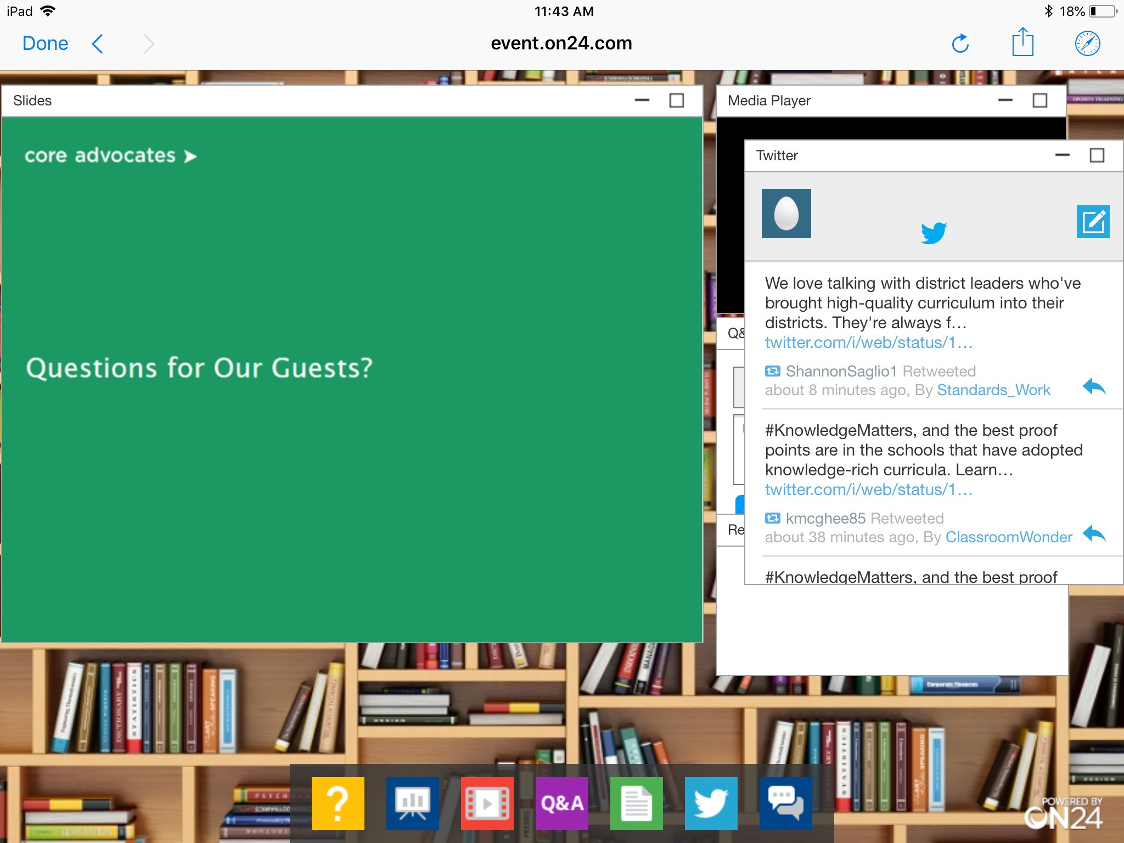
Tweet with Us!
Please feel free to tweet during and after the webinar using #coreadvocates and @achievethecore
Click here!

Slide 6

Engage with Us!
During the webinar:
Question just for the presenters/ tech help
Resources
Group chat
After the webinar:
– Access to recording will be emailed to you.
Take our survey in 2 weeks and receive a certificate verifying 1 hour of professional learning.

Slide 7
Goals of the (Mini) Webinar
Learn about the origin of the Quick-Reference Question Guides, their development, and their relationship to the Instructional Practice Guide and Lesson Planning Tool
Discuss potential use cases
Notes:
We have two main goals for our webinar tonight. They are to...

Slide 8
Section 1: The Origin of the Quick-Reference Discussion Documents

Slide 9
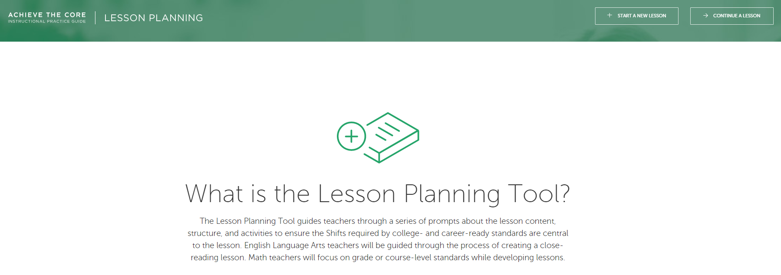
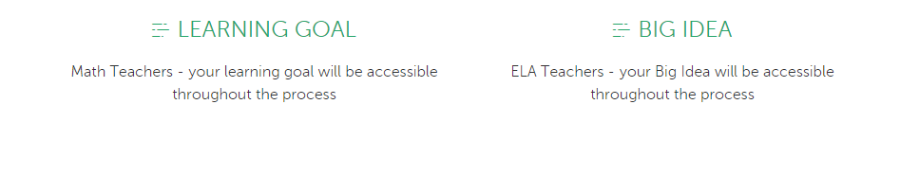
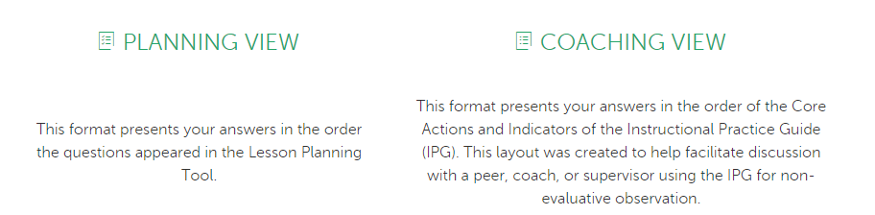
Notes:
The two resource documents we’ll be discussing tonight are a product of the interactive, digital lesson planning tool we have on our website, Achieve the Core. Though it’s a fantastic, free resource that walks educators through the entire lesson planning process and allows for easy sharing with coaches for feedback, we realized that not everyone has time to walk their way through the lesson planning tool for every single lesson. In addition, we realized that educators may want to talk about some of the components of lesson planning outside of the actual process of planning a lesson--whether this is in your PLCs or as a coaching conversation.

Slide 10
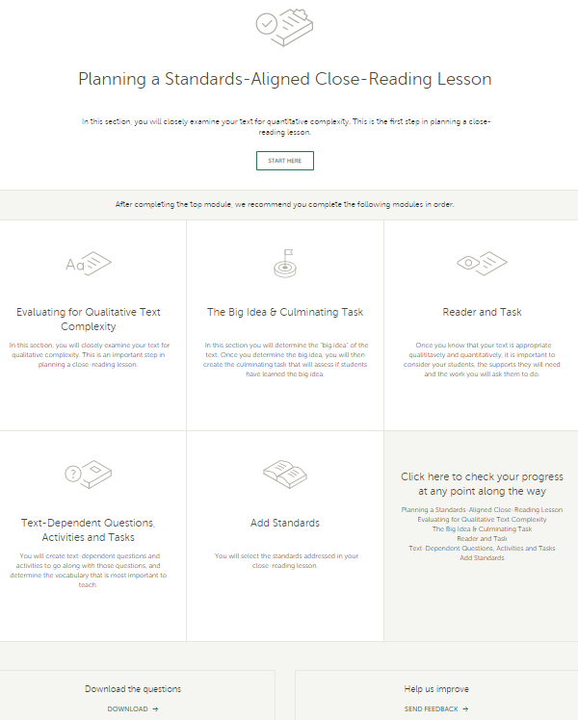
Accessing the Lesson Planning Tool document
Notes:
So then we took all the questions from the lesson planning tool and created downloadable documents but at approximately 16 pages each, they were weren’t something that one could easily print and use as a quick-reference tool every time they planned--either as an individual, within a PLC, or with a coach.

Slide 11
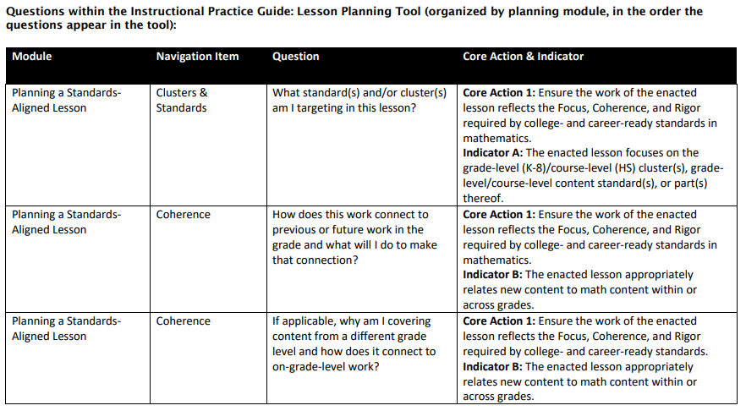
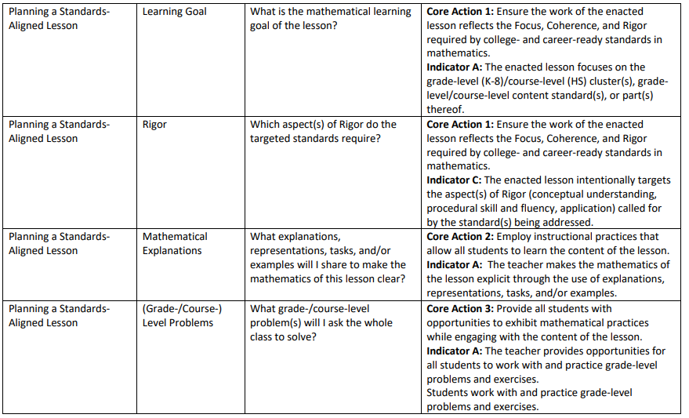
Sample of the original Lesson Planning Tool Resource Guide
Notes:
So with our minds set on creating a quick-reference tool, we

Slide 12
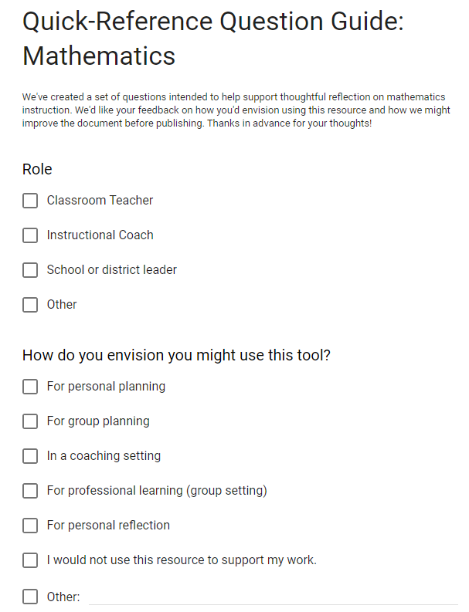
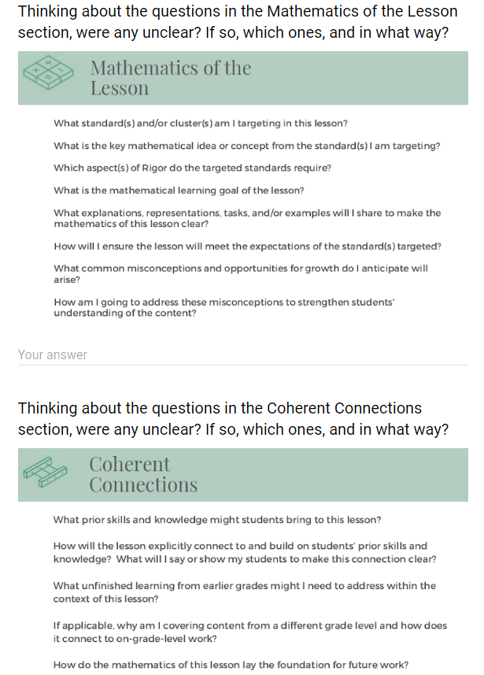
Notes:
We began our work with the math version. After we laid out the new, more user-friendly version, we surveyed math educators of all grade levels from all backgrounds. In addition to asking questions about each section of the document, we also asked how they might see themselves using this tool and had a few open-ended questions at the end asking for any other feedback they might like to share. We took their feedback filled with ideas and suggestions and made a final few tweaks before the math version was ready to go. Then we began working on the ELA version.

Slide 13

In the Group Chat, share one way you identify and select questions to discuss in professional learning settings.

Slide 14
Section 2: Meet the Quick-Reference Documents

Slide 15
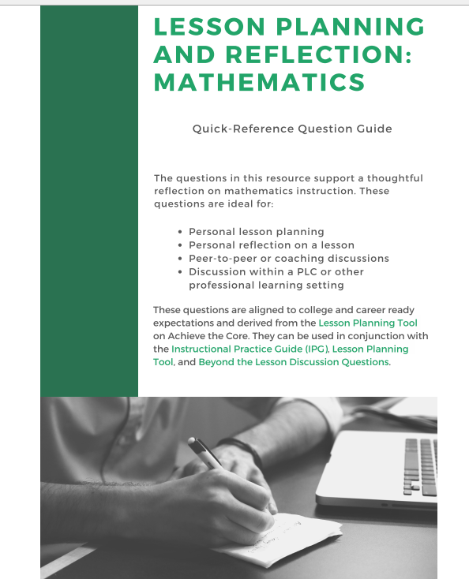
Math Quick-Reference Document
Questions on:
The Mathematics of the Lesson
Coherent Connections
Problems and Exercises
Formative Assessment Strategies
Classroom Discussions

Slide 16
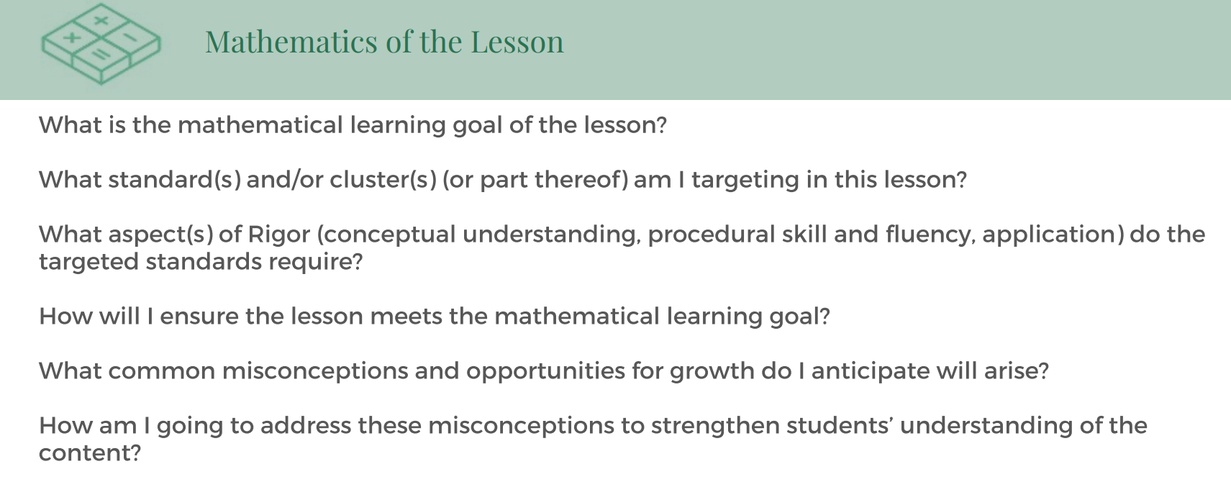
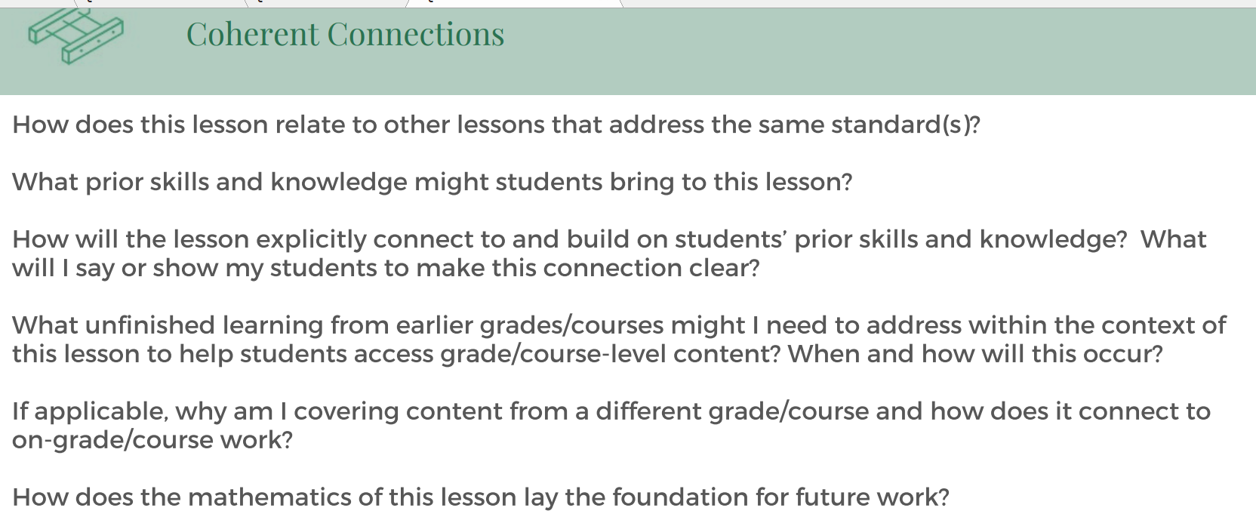
Math Quick-Reference Documents
Identifying goals of the lesson and how to plan for success.
Building upon students’ prior knowledge and skills.

Slide 17
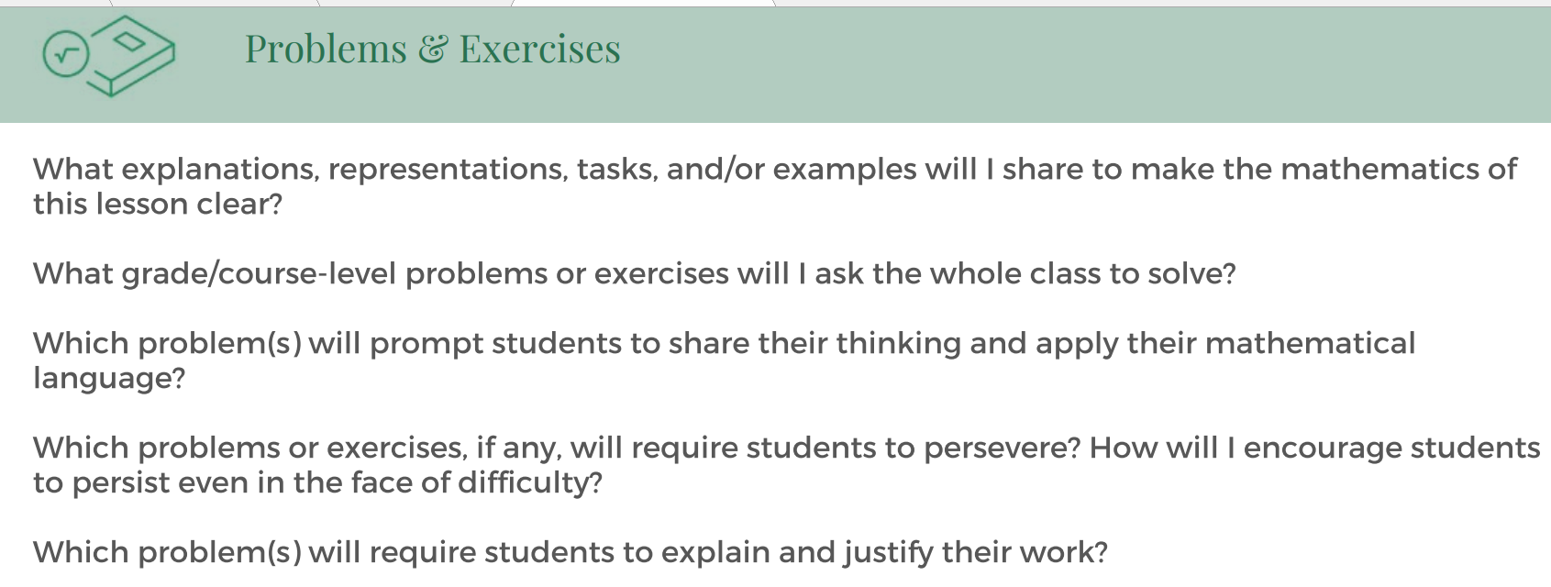
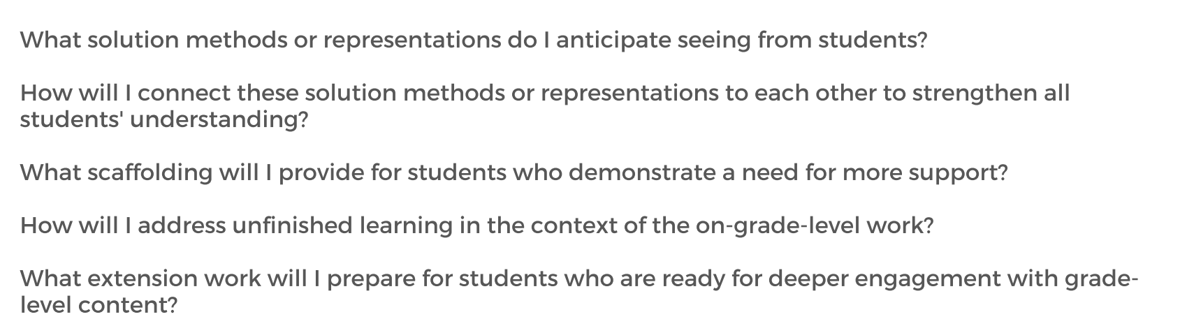
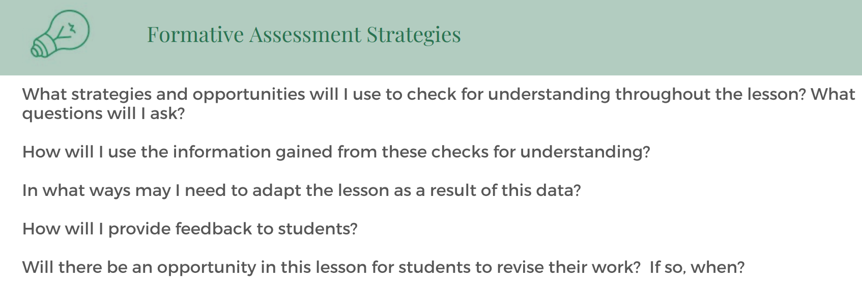
Math Quick-Reference Documents
Selecting high-leverage tasks and ensuring students’ success
Assessing students’ understanding

Slide 18
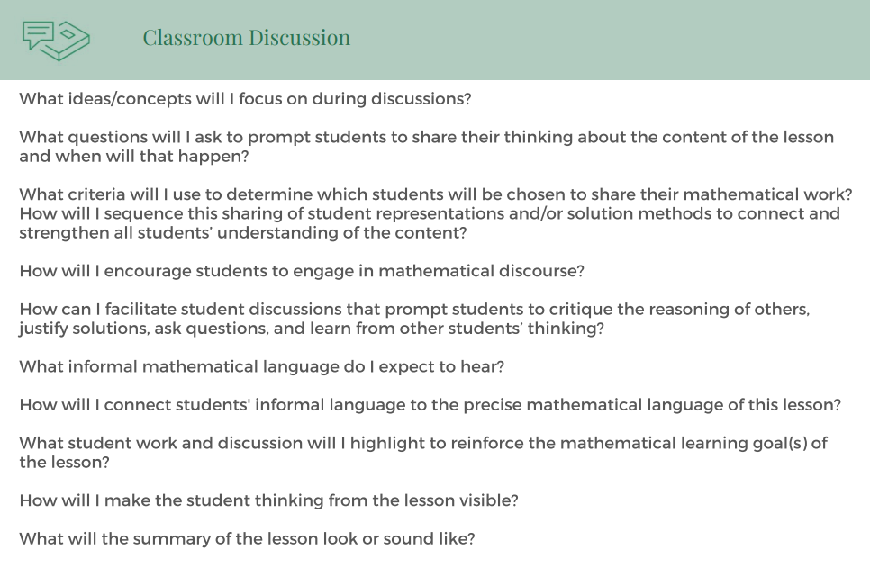
Math Quick-Reference Documents
Planning powerful classroom discussions that enhance understanding and confidence with mathematics

Slide 19
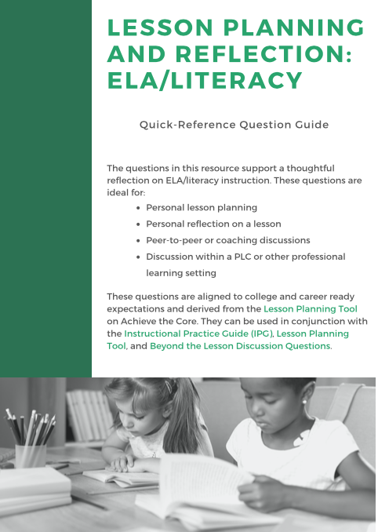
ELA/Literacy Quick-Reference Document
Reflection, planning, and discussion questions concerning:
Evaluating for text complexity
Reader and task considerations
The Big Ideas and culminating task of a lesson
Planning for text-dependent questioning, activities, and tasks
Student supports
Notes:
Talk about iterative design process
Walk through the different section headings and describe why we think these categories are important for reflection
Why we combined some sections and questions
Why we deleted some questions

Slide 20
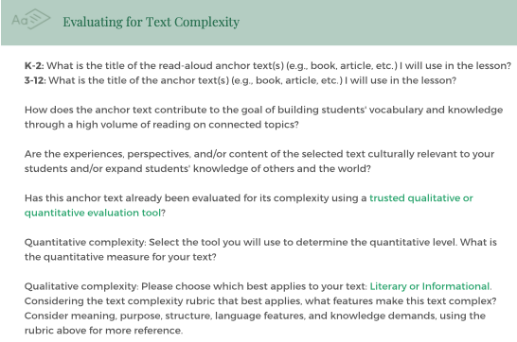
ELA/Literacy Quick-Reference Document
Evaluating your selected text for quantitative and qualitative complexity

Slide 21
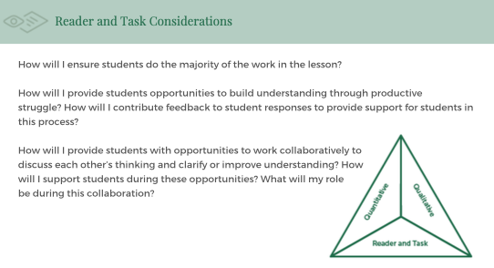
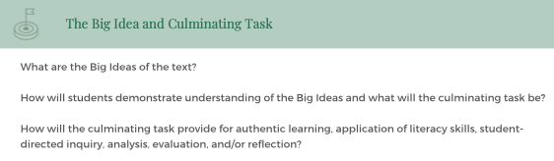
ELA/Literacy Quick-Reference Document
Considering the readers of the text and the engagement opportunities they will have
Unpacking the Big Ideas of the text

Slide 22
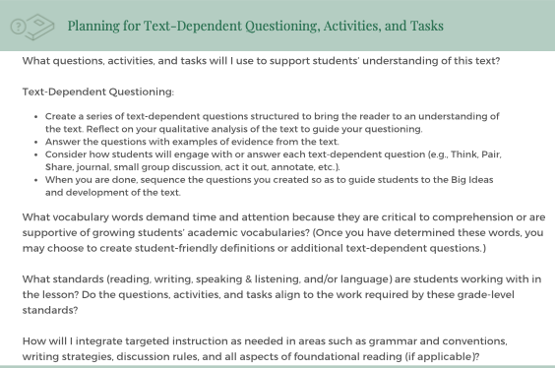
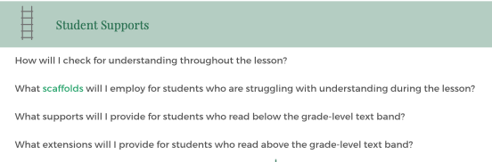
ELA/Literacy Quick-Reference Document
Planning for rigorous questioning, discussion, activities, and tasks that guide readers through the most complex parts of a text
Providing supports, scaffolding, and extension for students

Slide 23
Using the Quick-Reference Discussion Documents

Slide 24
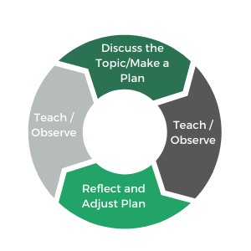
Using the Discussions Guides as a Coach
You might:
Talk through the process of planning a lesson
Focus on one question or section that addresses an area for growth
Add the questions to your Digital Coaching Menu
Hold a working session based on one of the questions (example: develop a plan for facilitating a math discussion)
Plan a cycle of coaching based on a question.

Slide 25

“Due to the curriculum we use, the teachers I work with currently teach major clusters the majority of the time. The difference comes in how the lesson looks in the classroom. I was excited by the questions. I think this will help me coach teachers in the actions they take when teaching major and supporting clusters. Are they teaching with the correct intention in mind?” -- Participant in Virtual Learning Course

Slide 26

Try these in your next PLC!
Notes:
If you have a weekly or monthly PLC meeting, add these quick reference documents to your next agenda! It’s a great opportunity to use the time you’ve already set-aside and have booked on a calendar as a way to either plan or reflect as a group. Just having time together to work your way through the questions will create the optimal time for group discussion and reflection.

Slide 27

Keep these tools on hand for individual preparation and reflection
Notes:
Lesson planning
An established lesson or starting from scratch
Helpful quick access to text selection and evaluative tools
Intellectual preparation
Envisioning for an upcoming lesson
Serves as a double check that lesson activities are aligned with standards or the rigor of the text
Lesson reflection
After a lesson, if something didn’t go to plan or didn’t feel rigorous enough, may want to use this as a tool to re-envision or re-teach
Peer to peer conversations and observations
Serves as a great discussion tool amongst peers

Slide 28





Please Join Us!
https://achievethecore.org/ca-signup
Twitter: twitter.com/achievethecore
Facebook: facebook.com/achievethecore
Pinterest: pinterest.com/achievethecore
Notes:
We encourage you to join the network by filling out this survey completely at atc.org/ca-signup

Slide 29
Please Join Us Again Next Month!
Next month’s webinar:
Integrating Curriculum and Assessment: An Example from Grade 3 Fractions
Wednesday February 5, 2020 @7PM EST
Register Here:
https://event.on24.com/wcc/r/2150740/03E89FBE735408378BE560611C1BF193

Slide 30
Thank You!

